Slide 1
Chores
A study in time spent

Slide 2
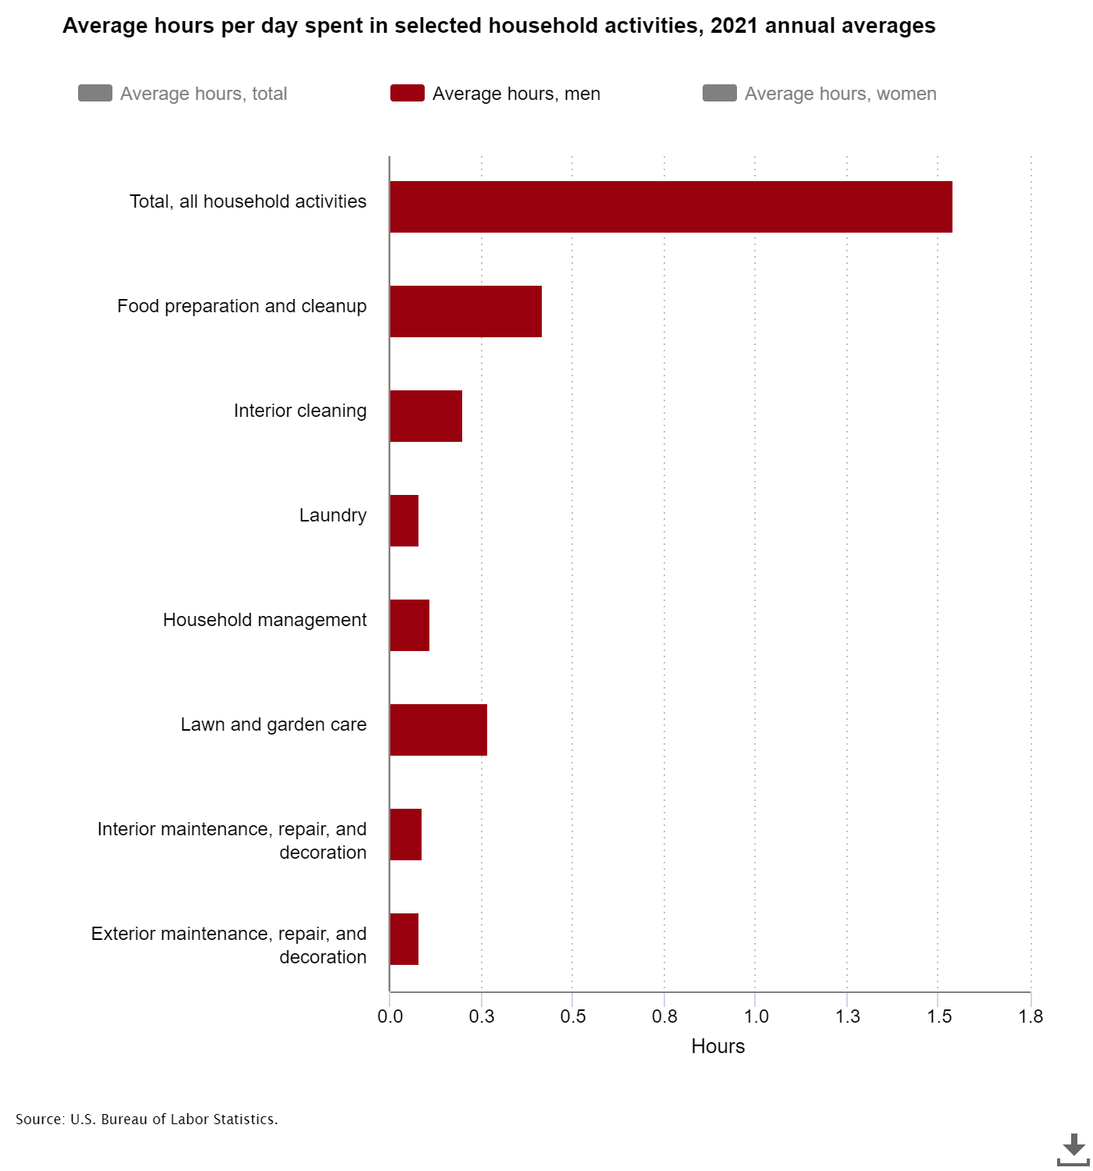
How do I compare to the average man?
For simplicity, only Food preparation and cleanup, Laundry, Interior cleaning, and Household Management will be measured for this project.
The average man spends a total of 0.81 hours per day on these chores.
This data can be found at https://www.bls.gov/charts/american-time-use/activity-by-hldh.htm

Slide 3




Chores Defined
House Management
Watering plants, feeding cats, replenishing supplies
Food Prep & Cleanup
All time spent cooking, plating, and clearing used dishes
Laundry
Running machines, folding clothes, putting clothes away
Cleaning
All time spent organizing and cleaning areas

Slide 4
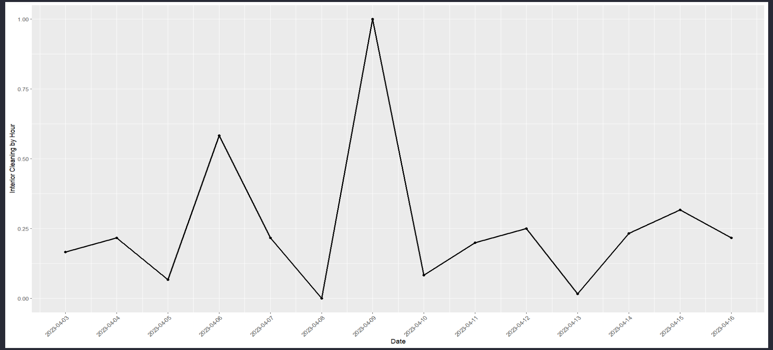
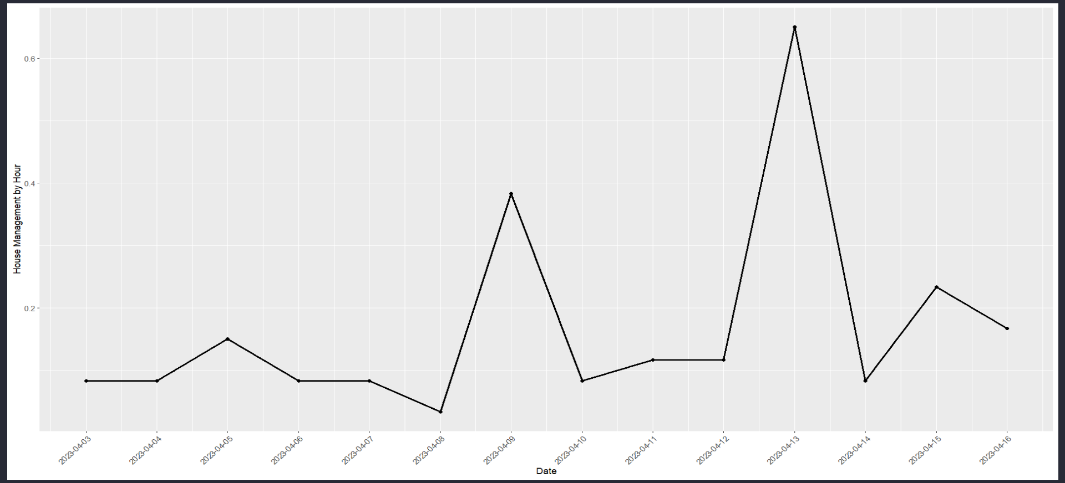
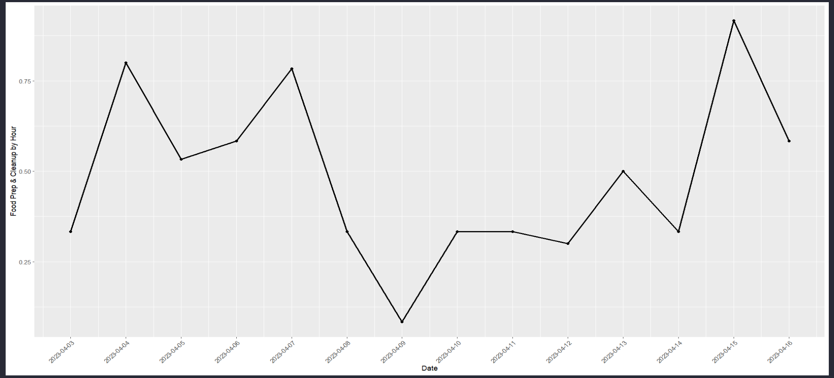
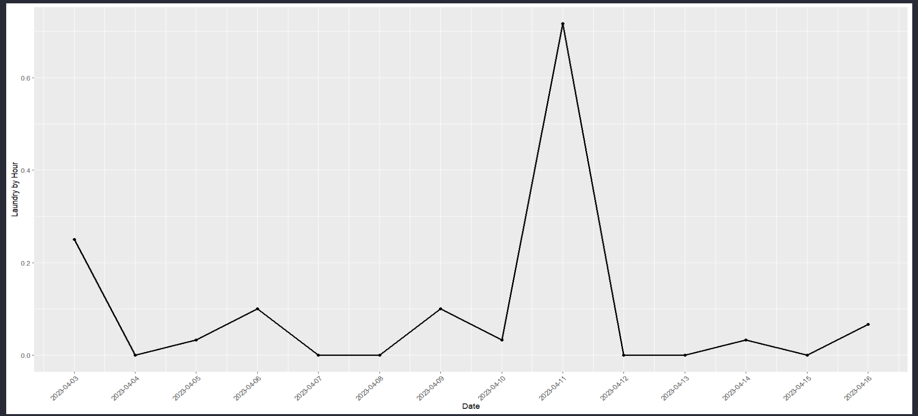
Time Spent by Chore per Day

Slide 5
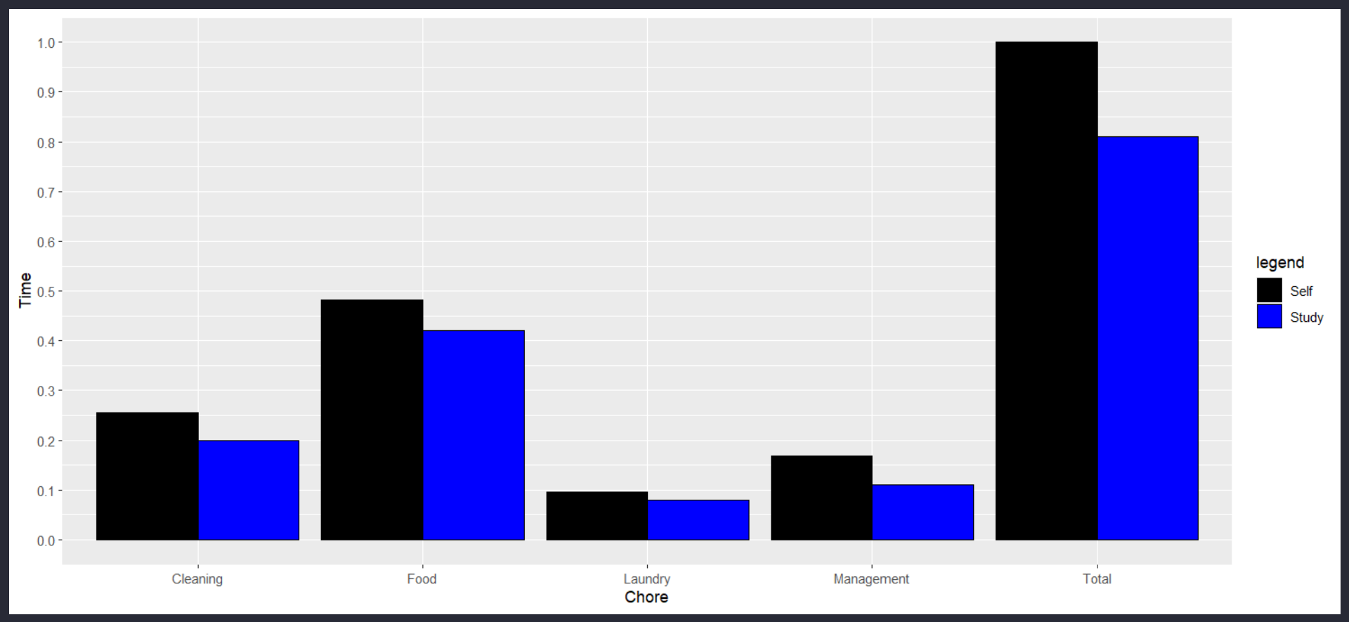
My Data Compared to the Study of Men

Slide 6
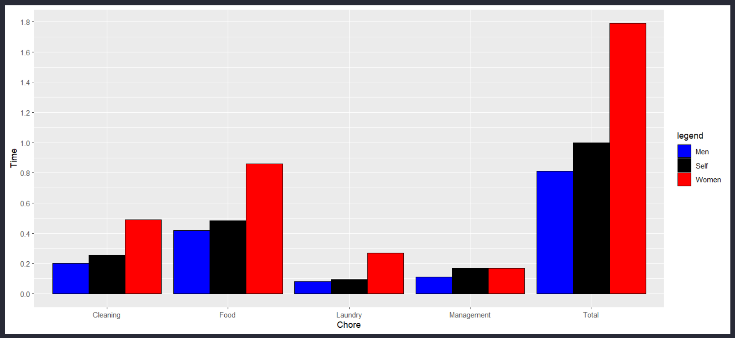
Adding Women to the Graph Widens Perspective

Slide 7
Claim: My Time is Significantly More Than Avg. Man
H₀: μ(Study) = 0.81 H_{a}: μ(Self) > μ(Study)
One-Sample, One-tailed T-Test
Method call: t.test(Data$Total, mu=0.81, alternative = “greater”)
Resulting values:
t: 1.94
p: 0.04
We will reject H₀; There is evidence to support the claim that I spend significantly more time on chores than the average man.

Slide 8

(Mental) Data Processing
Could the difference between me and the average man be due to measurement scope, two-weeks vs unknown?
What about survey method, were they observed or asked for their information?
Could my life be atypical?
Is my home reflective of the average home in the study?
Did I define the same way as the survey?

Slide 9

Conclusion
My time spent per day on chores is significantly above average for men, but below women.
The difference could be attributed to factors outside of the data available.
More studies should be conducted to iron out possible biases.

Slide 10
Thank You ☺

Slide 11
Github
https://github.com/ajones1992/Data-Visualization-Study

